Slide 1


WELCOME MEETING
INCOMING STUDENTS
“FALL 2025-2026”
FANI PAPOUTSI
ERASMUS+/ICM MOBILITY COORDINATOR
ADMINISTRATIVE OFFICER

Slide 2
PUBLIC SPEAKING
UNIVERSITY OF WEST ATTICA, GREECE
People often fear Public Speaking.
Talking in front of a new team, to crowded classrooms and unfamiliar people, makes us anxious and stressed.
Experiencing symptoms of performance anxiety like an increased heart rate, trembling hands and/or voice, or excessive sweating
is perfectly normal.
Standing is usually making us afraid to speak in public for many reasons:
Glossophobia (language - phobia)
Social anxiety – agoraphobia
Fear of mistakes
Hating the sound of the voice
Helpful tips:
Plan ways to connect with your audience
Stand up with your audience
Take a few “team” deep breaths…

Slide 3
UNIVERSITY OF WEST ATTICA, GREECE
UniWA was founded in March 2018, as a merging process of the former Technological Educational Institute of Athens (1974) and the former Piraeus University of Applied Sciences (1983).
2019 National School of Public health joined the University.
Today UniWA is the 3rd biggest University in Greece, with more than 57.000 undergraduate students, it includes twenty seven (27) departments, offering undergraduate, postgraduate and doctoral studies and it is organized into six (6) schools.
SCHOOL OF PUBLIC HEALTH
SCHOOL OF ADMINISTRATIVE, ECONOMICS AND SOCIAL SCIENCES
SCHOOL OF FOOD SCIENCES
SCHOOL OF HEALTH AND CARE SCIENCES
SCHOOL OF APPLIED ARTS & CULTURE
SCHOOL OF ENGINEERING
UNIVERSITY OF WEST ATTICA link: https://www.uniwa.gr/en/
Schools and Departments link: https://www.uniwa.gr/en/studies/schools-and-departments/

Slide 4
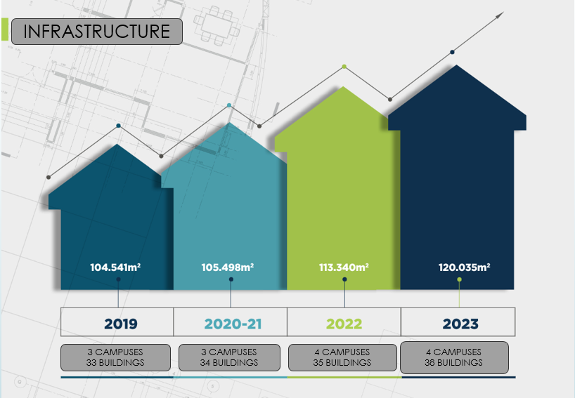
UNIVERSITY OF WEST ATTICA, GREECE
7 Schools
27 BScDepts
56.671
BSc students
27 MSc Programs
5.500
MSc students
780
PhD candidates
40
Post Doc

Slide 5
Erasmus+/ICM programme
Regional context – Eligible Countries:
Members of the European Free Trade Association (EFTA) which are members of the European Economic Area (EEA): Norway, Iceland, Liechtenstein;
Acceding countries, candidate countries and potential candidates: North Macedonia, Republic of Türkiye and Republic of Serbia;
Priorities
A European Green Deal
An Economy that works for people
Digital Age development
European Life promotion
European Democracy push
A stronger Europe in the world
Challenges
rising unemployment
climate change
economic and post-conflict migration
Digitalisation
Globalisation
physical inactivity and
the multilingual structure of Europe’s united but diverse nations.

Slide 6
University of West Attica
MISSION – Education of excellent quality
VISION – Global - International recognition
STRATEGY :
Educational Excellence
Research Development
Digital Transformation
Improvement of Academic Environment
Accountability and Transparency
Extroversion – Internationalization
Sustainability and Sustainable management of Resources
Quality Assurance
ERASMUS+ STRATEGY
Inclusion and Diversity
Digital Transformation
Environment and fight against climate change
Participation in democratic life, common values and civic engagement

Slide 7
UNIVERSITY OF WEST ATTICA, GREECE
FEWER OPPORTUNITIES
The E+ Programme,
seeks to promote equal opportunities and access, inclusion, diversity and fairness across all its actions.
Organisations and the participants with fewer opportunities themselves are at the heart of these objectives and with these in mind, the programme puts mechanisms and resources at their disposal.
The UNIWA, in respect with the different backgrounds and needs, offers free mentoring in relation with each E+ participant’s needs.
Participants with disadvantaged backgrounds and fewer opportunities are prioritized, more specifically:
Cultural differences
Disability
Economic obstacles
Educational difficulties
Geographical obstacles
Health problems
Refugees
Social obstacles
UNIWA will support :
the priority areas selected
the participation of representatives of less developed sub-regions and
individuals with fewer opportunities, as well as ensuring a gender balance.

Slide 8
INCLUSION AND DIVERSITY
Due to the numerous benefits of inclusion, the University of West Attica, as an inclusive university, has established a strategy where, in its fully accessible facilities, everyone is welcomed, feels valued, included, and respected.
Accessible spaces, premises and parking for people with disabilities (lifts, ramps)
Accessibility services in UniWA’s libraries (work stations for people with disabilities)
Healthcare and medical clinics for students and staff
Best practices for handling healthy restaurants’ meals and following the Mediterranean eating pattern, inclusive of medical, religious, ethnic and philosophical concerns (three free meals per day for all students, alternative choices to cover all needs)
New partnerships that enhance university’s commitment to work with diverse populations
Student advocacy service
Psychosocial Support and Research Laboratory in Councseling Psycosocial Support and Community Interventions
Gender Equality and Anti-Discrimination Committee (G.E.A.C.)
Multilingual inclusion officer
Career counselling and guidance services
Career liaison and innovation office that connects the University’s community with local and national authorities

Slide 9
UNIVERSITY OF WEST ATTICA, GREECE
ERASMUS+ PROGRAMME
1984 – E+ 1st Entry
1987 - Beginning of ERASMUS at former TEI of Piraeus
2015 – ICM Launch
2016 – member of the International Credit Mobility team as the programme country
2016 – 2025 more than 2.000 incoming and outgoing (students and staff) mobilities have been allocated to the University of West Attica with an absorption average approx. 88%.

Slide 10
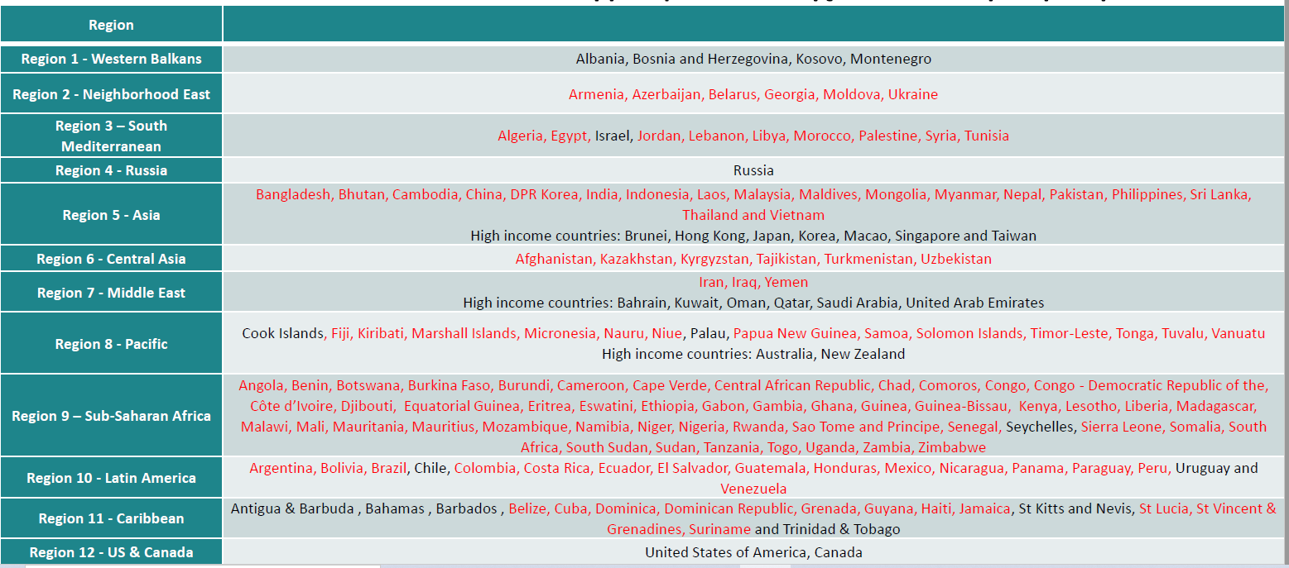
GEOGRAPHICAL TARGETS - LIMITATIONS
Red Coloured Counties, can send students from all three levels of studies.
Greece can send only PhD students to the red-coloured countries.
Black coloured countries can accept and receive students from all three levels of studies.

Slide 11
ERASMUS+/INTERNATIONAL CREDIT MOBILITY (ICM)
Student Mobilities - Studies
Long-Term Student mobilities 2 -4 months
Accepted level of Studies:
Undergraduates
Postgraduates
Doctoral
Post Doctoral
Requirements for Application
Valid Inter – Institutional Agreement between UniWA and Partner University
Having completed the 1st academic year (for Bachelor level only)
English B2 level.
Erasmus+ mobility duration
From 5 days up to 4 months (according to the approved funding)*

Slide 12
TEAM BUILDING – BONDING EVENTS
INTERNATIONAL WEEKS
STAFF WEEKS
MIXED MOBILITY – STAFF WEEKS
EDUCATIONAL WEEKS for supervisors and PhD candidates
CO – TEACHING PANELS
INFO – DAYS
What we are committed to doing is:
spending meaningful time together
fostering trust, and
strengthening loyalty both to the teams and to one another.

Slide 13
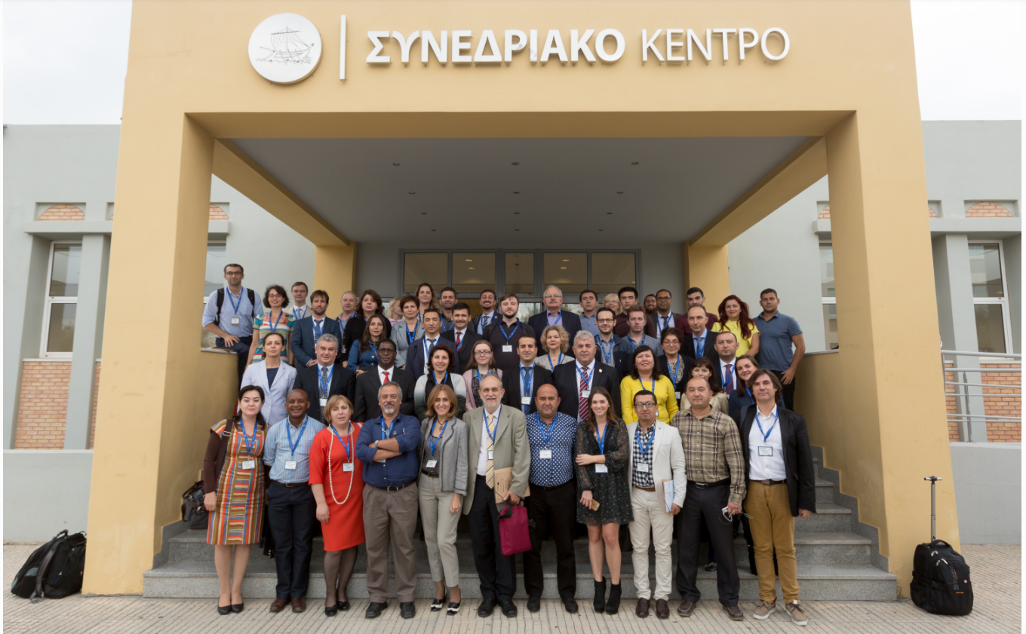
UNIVERSITY OF WEST ATTICA, GREECE
University of West Attica organizing Erasmus International weeks and conferences
1st INTERNATIONAL WEEK 2017 (video)
30th anniversary of the ERASMUS program
23 partner Higher Education Institutions (HEIs), non-European Union countries, Asia (Armenia, Azerbaijan, Georgia, Kazakhstan, Iran, Jordan, Uzbekistan and Tajikistan), Africa (Tunisia, South Africa and Kenya), the US and Russia

Slide 14
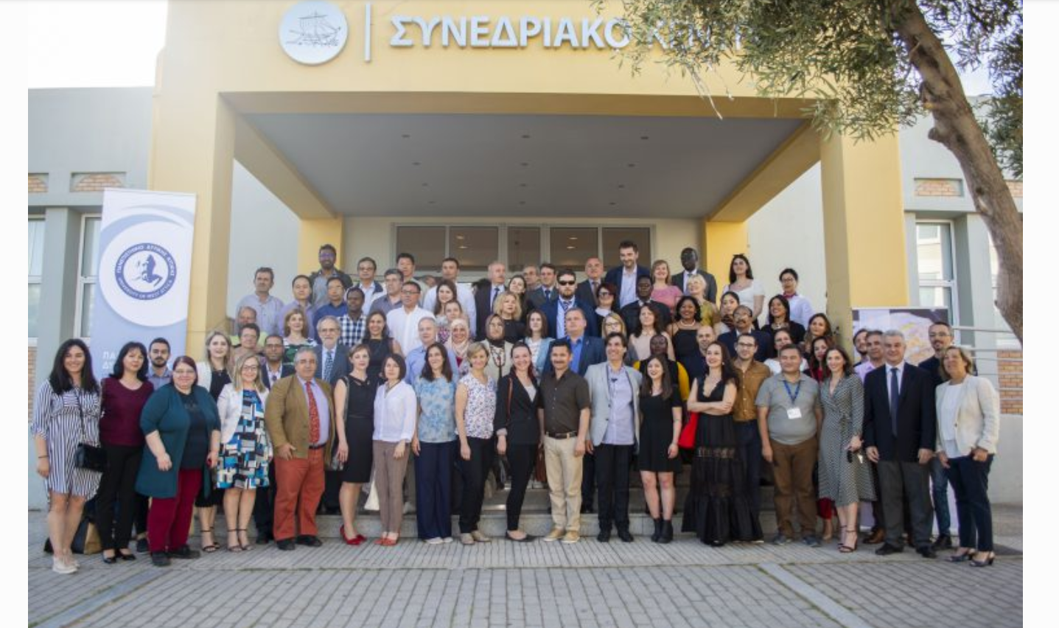
UNIVERSITY OF WEST ATTICA, GREECE
2nd Erasmus+ International Credit Mobility Week 2019 (video)
51 Universities
29 Non-EU countries

Slide 15
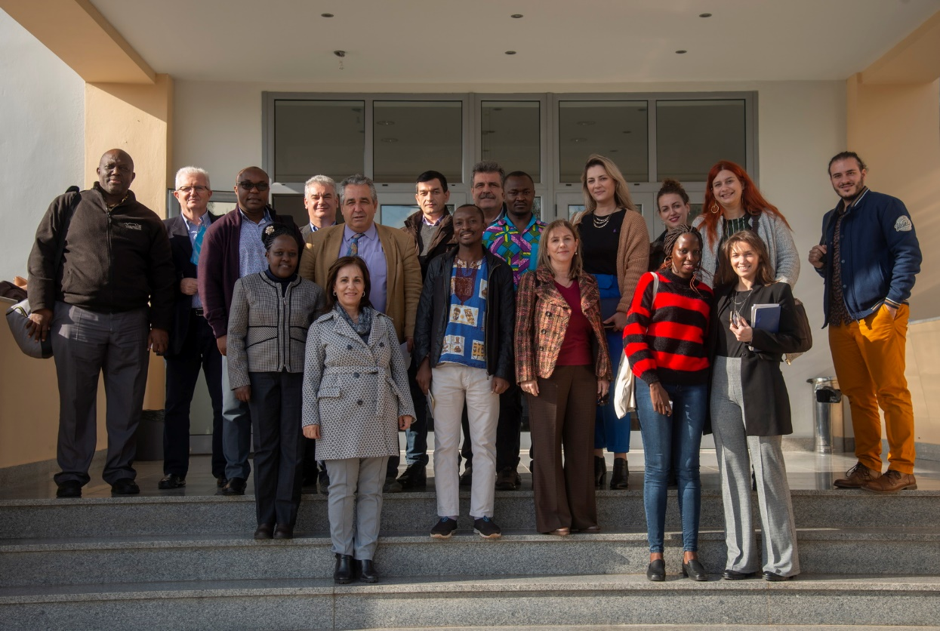
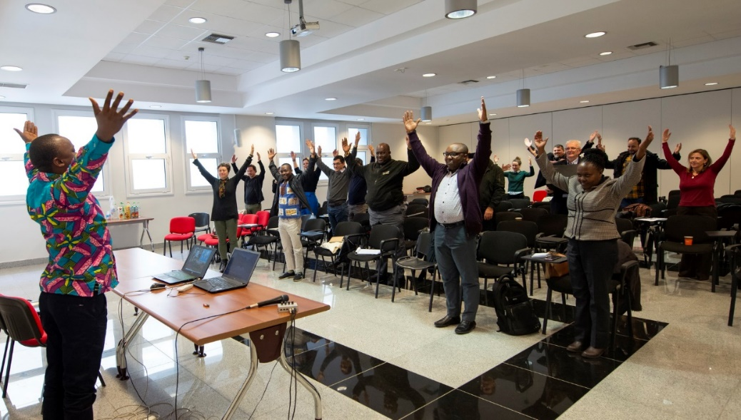
UNIVERSITY OF WEST ATTICA, GREECE
Greek – African Erasmus+/ICM Day 2020
Greece - Kenya – Uganda – Benin
Youth makers hub _WeAfriHug team

Slide 16
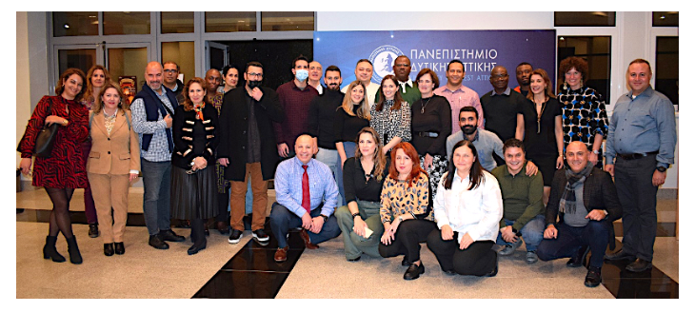
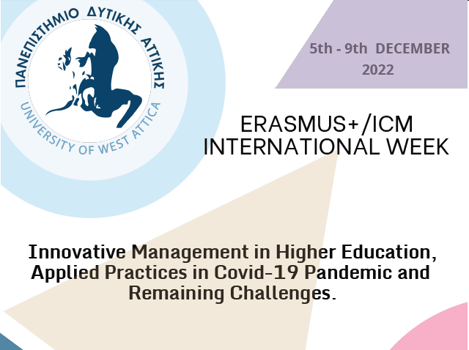
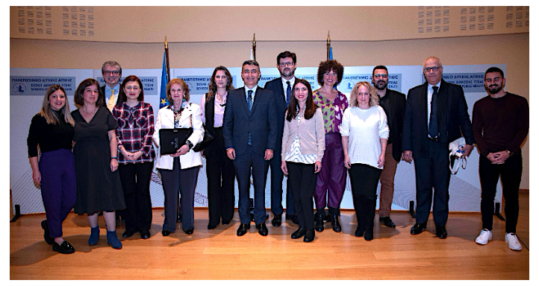
3rd Erasmus+ International Credit Mobility Week 2023

Slide 17
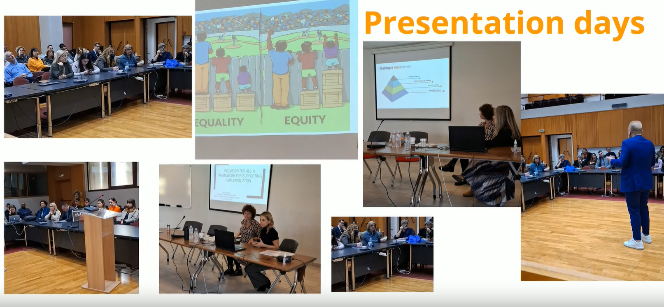
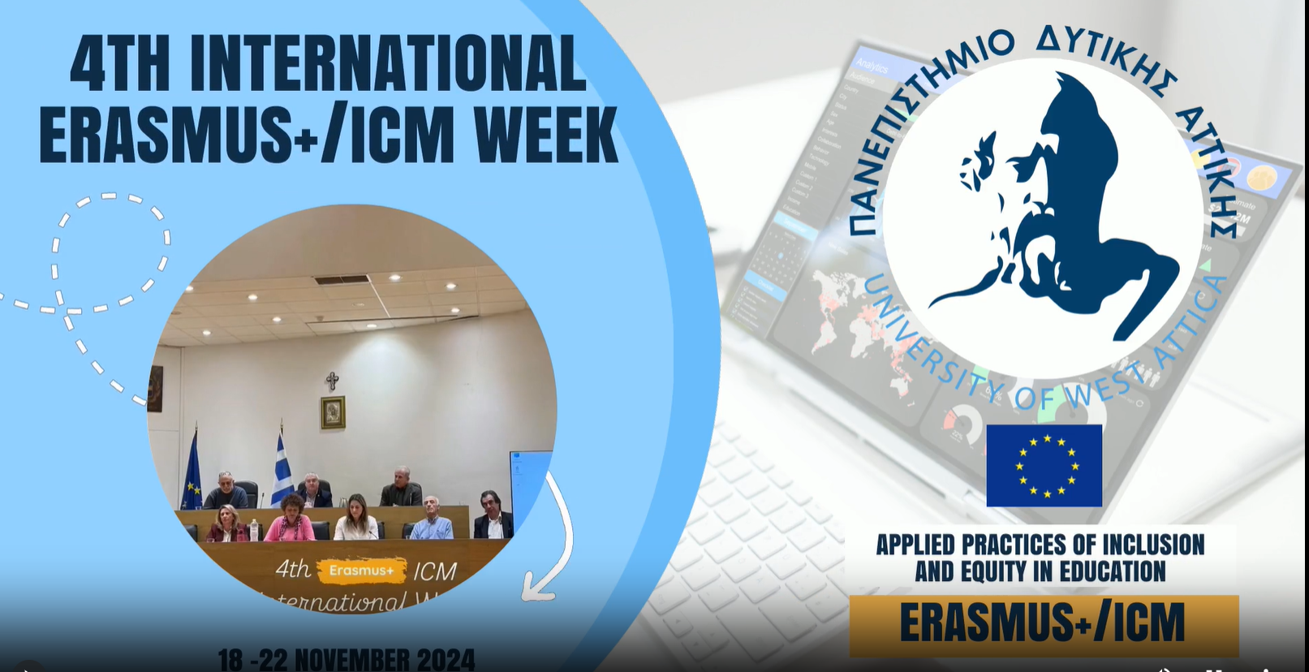
4th ERASMUS+/ICM INTERNATIONAL WEEK:
“Applied practices of Inclusion and equity in education”

Slide 18
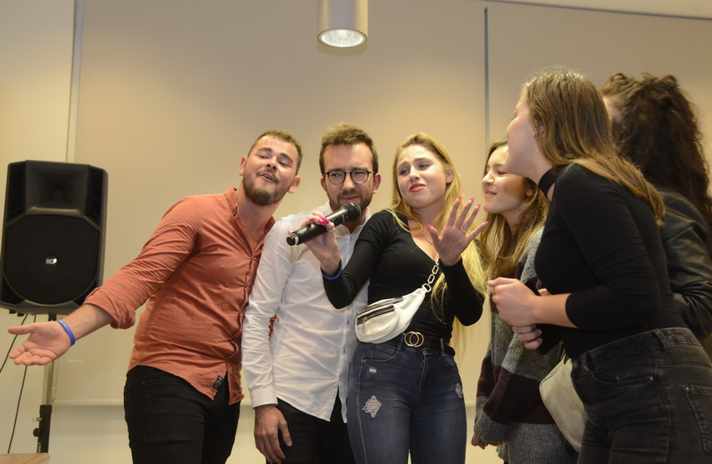
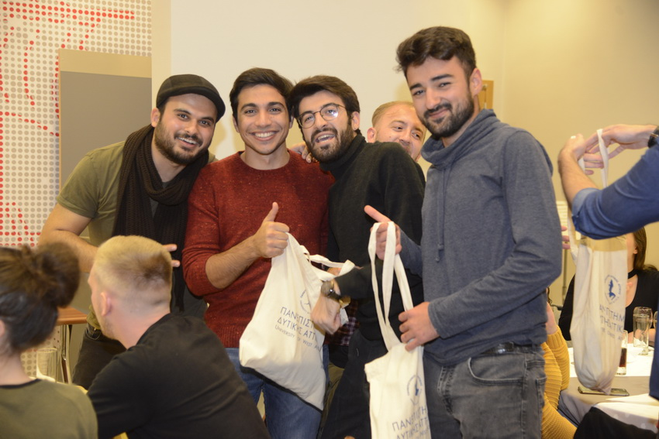
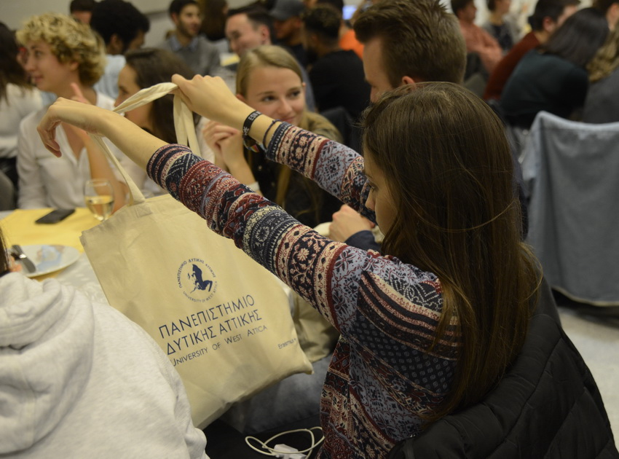
Student Events

Slide 19
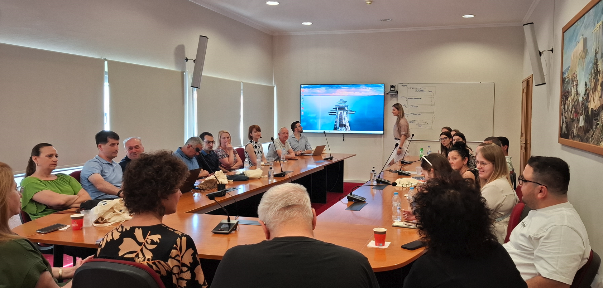
Educational Week for Supervisors and PhD candidates
The first International Week for PhD candidates and their supervisors is an international event designed to foster academic excellence, cross-border collaboration, and professional development in doctoral education. Bringing together, early-stage researchers and their mentors from diverse countries, disciplines, and backgrounds, the program aims to offer interactive workshops, keynote lectures, and peer exchange sessions.

Slide 20
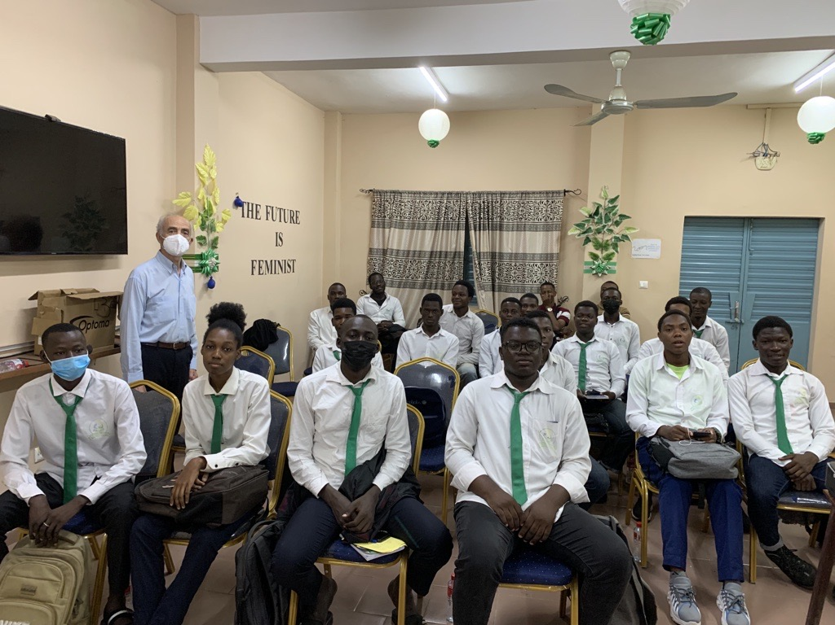
Good Practices – Past Performance
One of the cooperation topics was a series of lectures to the teaching staff and students of the four universities on the handling, proper use and possibilities of the “Remote Photovoltaic Laboratory” (http://alioslab.uniwa.gr), installed on the roof of the University of West Attica (UniWA).
The “Remote Photovoltaic Laboratory” has been developed by the renewable energy laboratory of UniWA and offers the ability to engineering students and teachers to remotely conduct experiments with real-world solar photovoltaic equipment and under real weather condition, helping the student to become capable of putting the theory into practice.
Thus, the students of the final years, started to conduct experiments, taking measurements with the Greek sun while, at the same time, they can have a live view of the photovoltaic panels through a web camera.
The system also has an Open Educational Resources, which covers the whole theory of photovoltaic technology and consists of 16 chapters in five languages ( ES, FR, GE, GR, UK).
It is worth mentioning that in these countries, due to the lack of electricity grid, photovoltaic installations are growing exponentially with a parallel demand for qualified graduates in the corresponding subject.
Emeritus Professor Petros Axaopoulos
Mechanical Engineering

Slide 21
Good Practices – Past Performance
Νew food product development/alternative sustainable food source
Traditional Ethiopian diets used to exchange information and personal experience via interactive courses (online & physical presence) with a crowd of PhD students.
An unknown to the Greek diet grain for gluten intolerant consumers, being researched and future opportunities, such as income boost from its use/consumption are under consideration.
The research on the specific grain, is a subject area for analysis at the department.
Professor Anastasia Kanellou
Food Science

Slide 22
Mrs. Fani Papoutsi (fanpapoutsi@uniwa.gr)
THANK YOU FOR YOUR ATTENTION

